Slide 1


Chatbot
Department of Justice website
for
Aari Eswar
21VV1A1201

Slide 2


Agenda
This project aims to develop a chatbot or virtual assistant that assists users in accessing information related to the DoJ, such as:
Understanding various DoJ divisions
Information on appointments and vacancies in the judiciary
General knowledge about case pendency data through the National Judicial Data Grid (NJDG)
Procedures for traffic fine payments
Steps for eFiling and ePay
Overview of Fast Track Courts
How to download the eCourts Services Mobile app
Information on Tele Law Services
Guidance on checking the status of cases

Slide 3


Project Overview
Main Features
The chatbot boasts several key features designed to enhance user interaction. It utilizes natural language processing (NLP) to understand user queries and generate appropriate responses. Additionally, the chatbot is designed with a user-friendly interface, making it easy for individuals to engage in conversation without technical barriers.
Technologies used
The project employs Django as the backend framework, facilitating robust web application development. The RAG model combines retrieval-based methods with generative capabilities to provide responses, while the database (e.g., SQLite or PostgreSQL) stores user queries and responses. The frontend is built using HTML and CSS, integrated seamlessly with Django templates for a cohesive user experience.

Slide 4


How RAG Works
Retrieval-Augmented Generation (RAG) is a powerful technique that combines two essential components: retrieval and generation. The retrieval process fetches relevant information from a knowledge base or dataset, while the generation component creates coherent and contextually appropriate responses based on the retrieved information. This synergy allows for more nuanced interactions.
Process
The interaction begins when a user inputs a query into the chatbot interface. The system then retrieves relevant documents or data that relate to the user’s question. Finally, the RAG model synthesizes this information to generate a human-like response. This method not only improves response accuracy but also enriches the user experience by providing informative and engaging conversations.

Slide 5
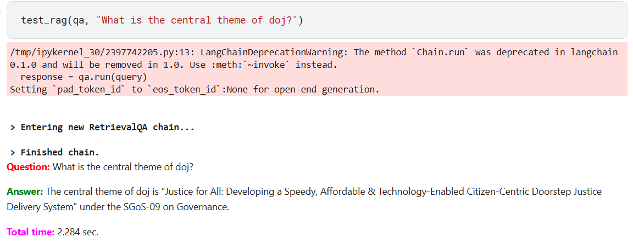
About The Application
I’ve used llama 3.2 1-b instruct as a pretrained model . and used transformers and langchain to build a pipeline to build this retrieval QA chain .
By taking all the data through the pdf i am able to store the chunks of the textual data in vector db for efficient use of search in the trained data.

Slide 6
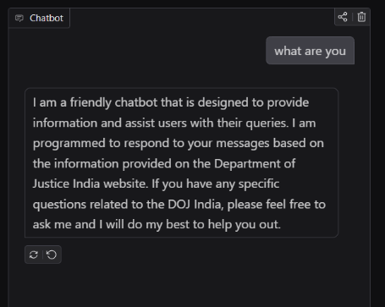
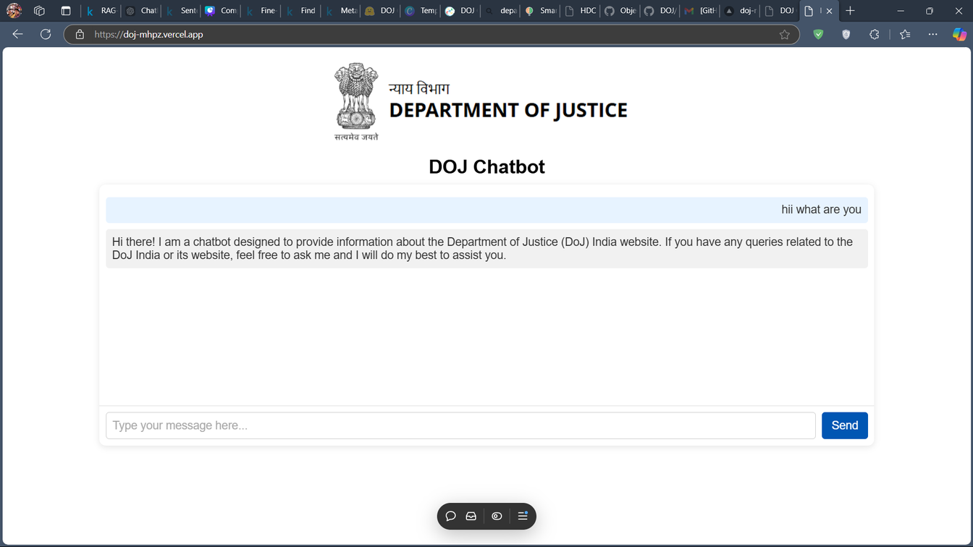
About The Application
This DOJ ChatBOT is deployed in Vercel by using API’s of Hugging Face
https://doj-chatbot-ek.vercel.app/

Slide 7
Thank YOU

